Slide 1
SIT113 Cloud Computing and Virtualisation
Week 5, Class 1
Networking

Slide 2
Outline
Basic Concepts
Traffic Management

Slide 3
Basic Concepts
Computer Networks
Main Network Devices
Specialist Devices

Slide 4
Basic Concepts: Computer networks
Computer networks represent the means through which we interconnect computers for the purpose of data interchange
Applications are then built on top of this data interchange, e.g., email, web, storage, and so on.
A protocol is needed for data interchange.

Slide 5
Basic Concepts: Computer networks
Networks are generally defined in terms of:
Architecture
Topology
Protocols

Slide 6
Basic Concepts: Computer networks
1. Network Architectures
Local Area Network (LAN):
small in size and geographic area
two or more connected devices
Wide Area Network (WAN):
larger in size and geographic area
two or more connected systems in geographically separated areas
variety of methods to connect these systems

Slide 7
Basic Concepts: Computer networks
1. Network Architectures
Campus Area Network (CAN):
two or more connected buildings

Slide 8
Basic Concepts: Computer networks
1. Network Architectures
Intranet:
A “private” network
accessible only to authorized users
Internet:
“The global network”
millions of connected systems

Slide 9
Basic Concepts: Computer networks
2. Network Topology
The physically or logically arrangement
Main classes of network topologies:
star
ring
bus
mixed

Slide 10
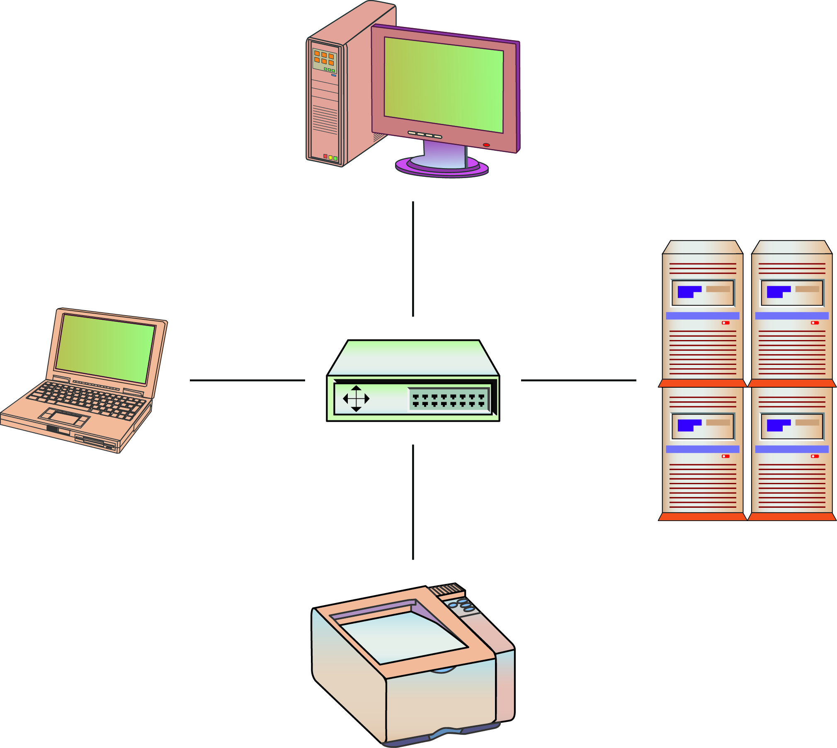
Basic Concepts: Computer networks
Star Topology
Devices are connected to a central point

Slide 11
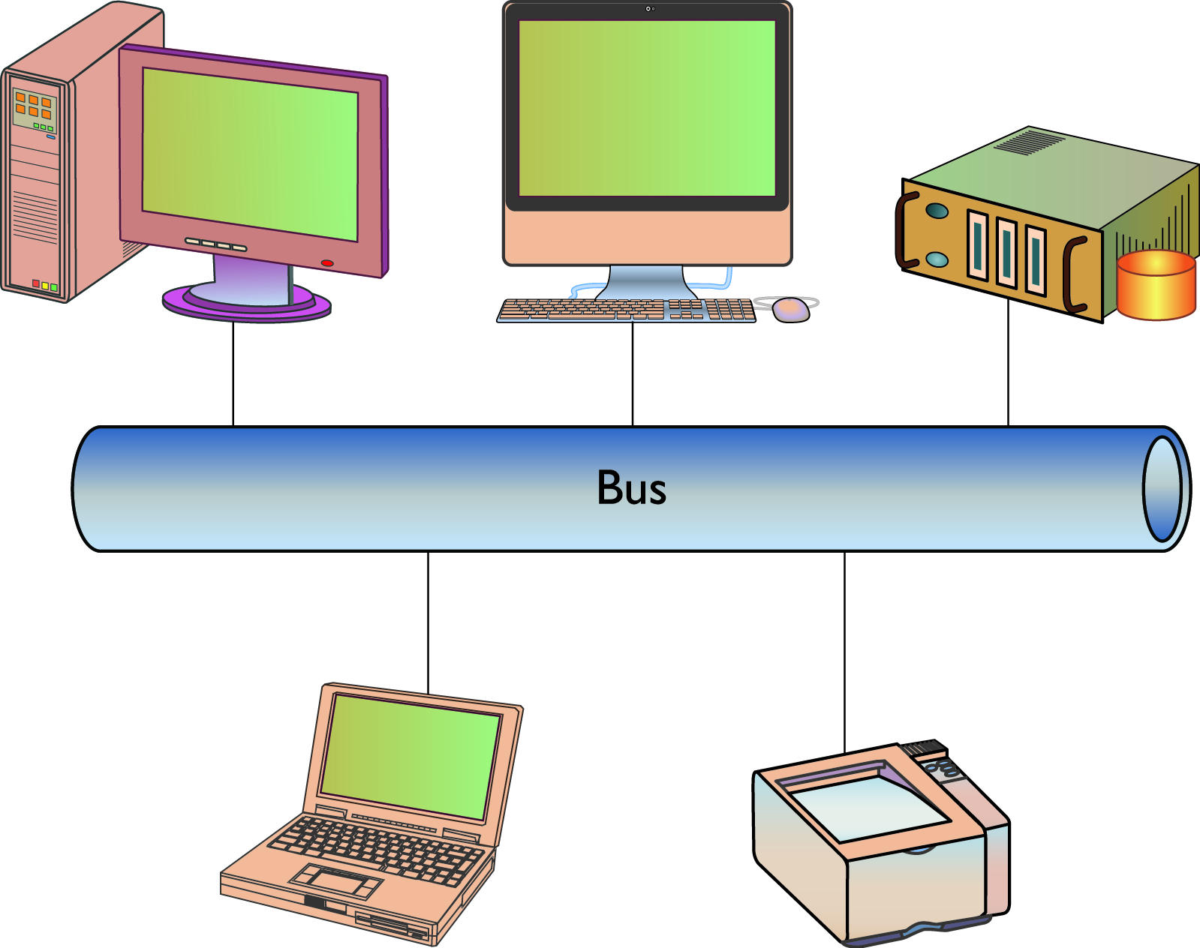
Basic Concepts: Computer networks
Bus Topology
Devices are connected to the same cable, often called “the bus” or “the backbone.”

Slide 12
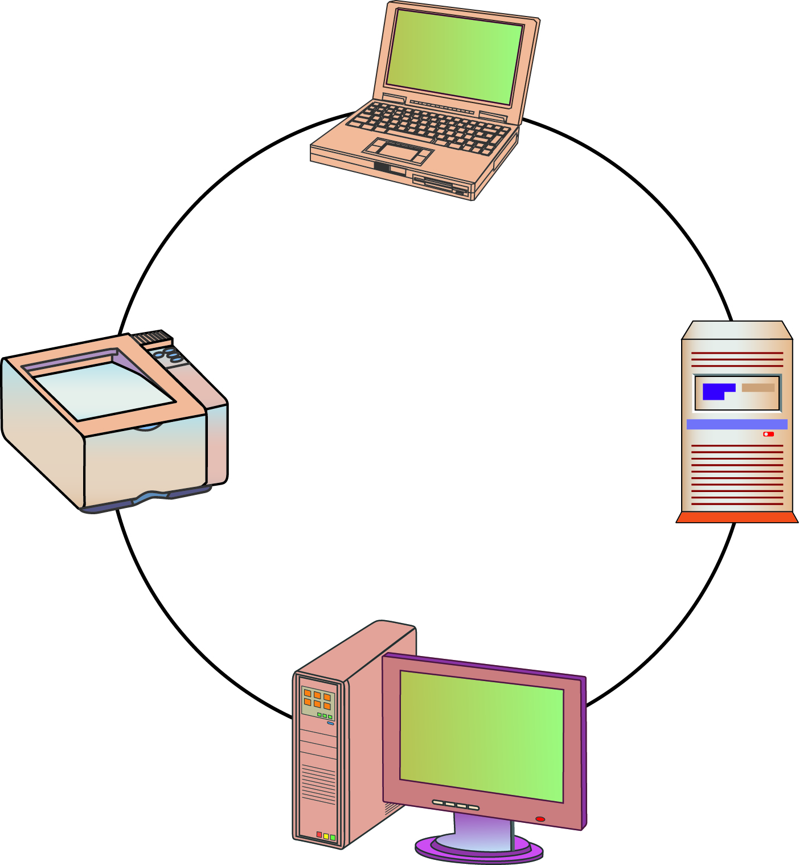
Basic Concepts: Computer networks
Ring Topology
Devices are connected in a closed loop
Each device is connected to two other devices

Slide 13
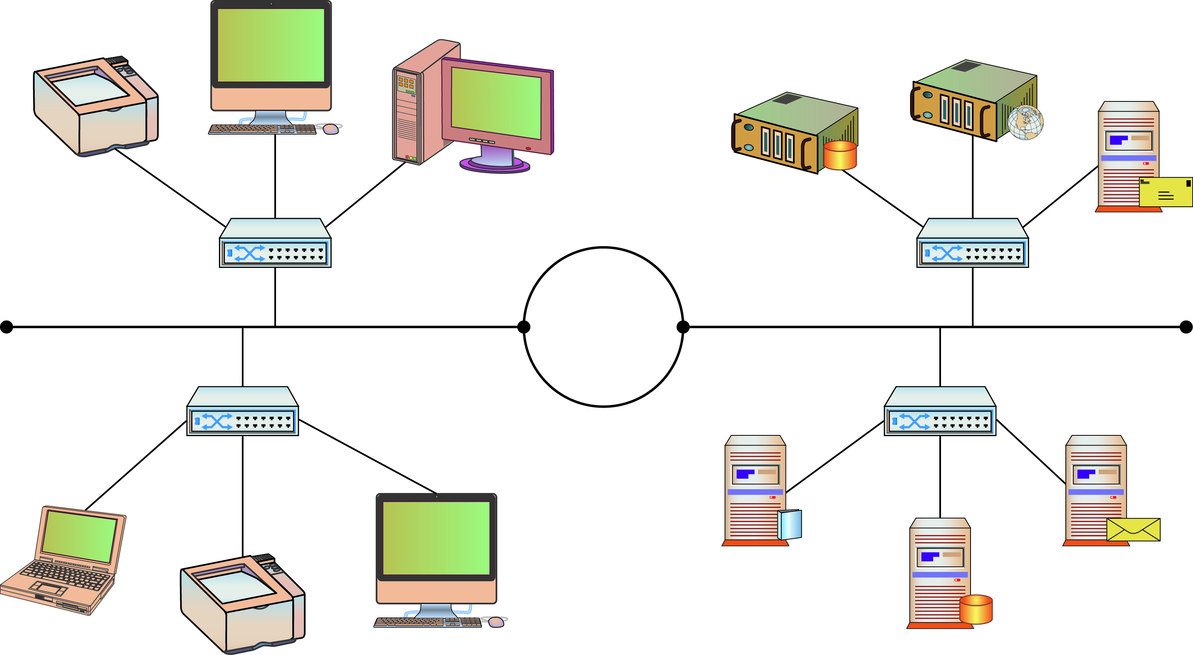
Basic Concepts: Computer networks
Mixed (Hybrid) Topology
Large networks using more than one topology

Slide 14
Basic Concepts: Computer networks
3. Network Protocols
A protocol is an agreed-upon format to transmit data between systems.
A protocol defines a number of parameters such as:
the data compression method
the type of error checking to use
mechanisms to signal when systems have finished receiving or transmitting data

Slide 15
Basic Concepts: Computer networks
3. Network Protocols (Common)
Ethernet: most widely implemented LAN protocol
Internet Protocols (IP):
Hypertext Transfer Protocol (HTTP)
Email (SMTP)
Network Time Protocol (NTP)
File Transfer Protocol (FTP)
Telnet
Etc.

Slide 16
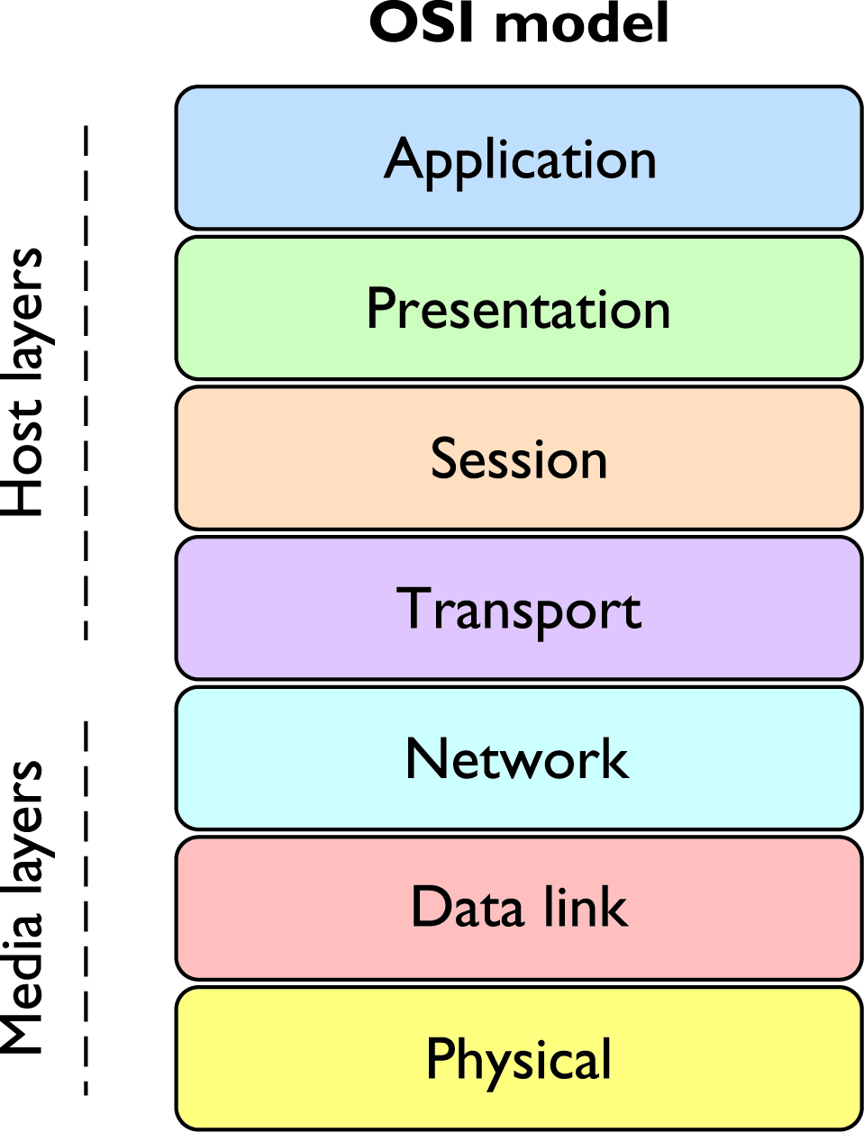
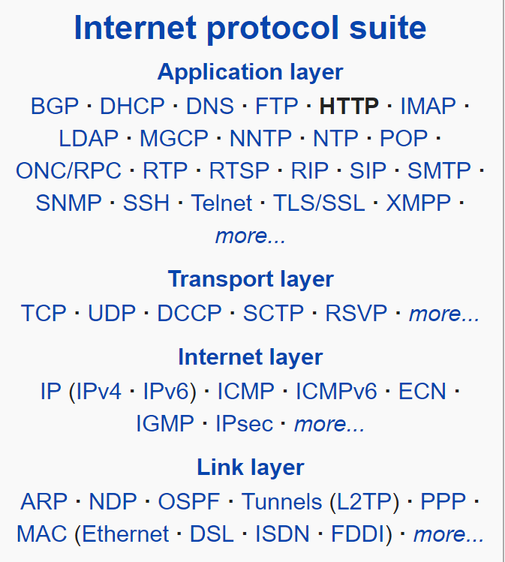
The OSI Model

Slide 17
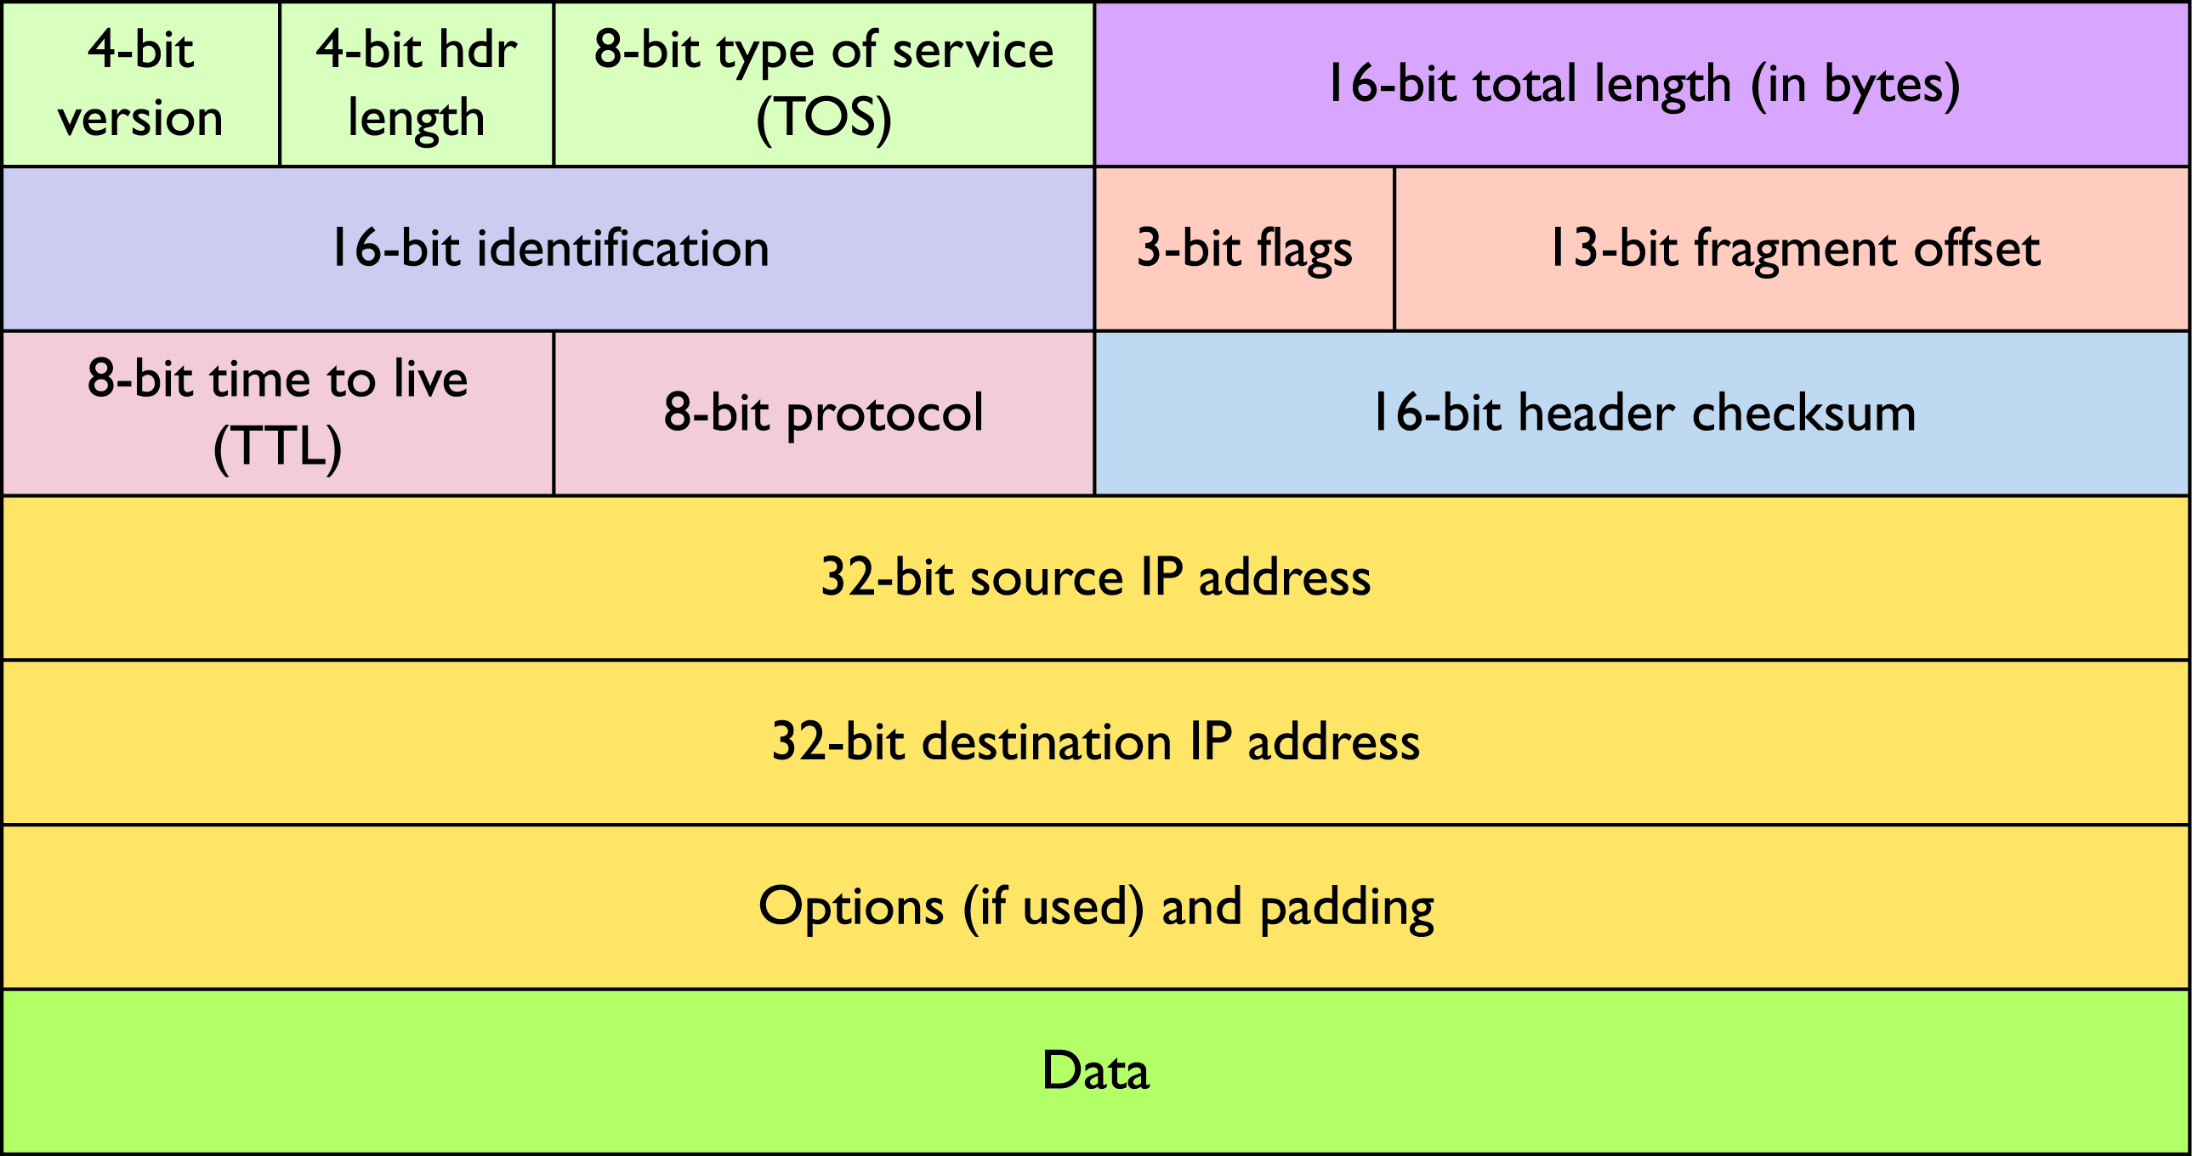
IP Packet (datagram)
An IP packet has 2 sections: header and data

Slide 18
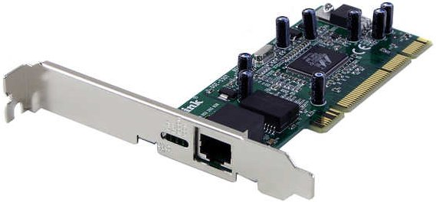
Basic Concepts: Computer networks
Devices for accessing the network, e.g., interface cards (NICs) in PCs/laptops/servers, tablets, phones, etc.
Interconnection technologies, e.g., Ethernet cabling (CAT 5/5e/6/etc.), fibre optic, DSL over telephone wire, WiFi, etc.
A gateway is a network node that serves as an access point to another network

Slide 19
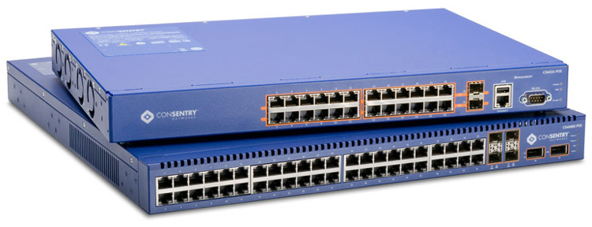
Basic Concepts: Main Network Devices
Switches: used to connect multiple network devices via cable forming a LAN
Most commonly IEEE802.3 Ethernet networks running at 100Mbps, 1Gbps, 10Gbps, 40Gbps, and 100Gbps

Slide 20
Basic Concepts: Main Network Devices
WiFi Access Points: used to connect multiple devices via wireless transmissions forming a LAN
Most commonly IEEE802.11 networks running at speeds of 54Mbps(802.11a/g), up to 600Mbps(802.11n), or up to 6.93Gbps(802.11ac)

Slide 21
Basic Concepts: Main Network Devices
Routers: used to connect multiple networks together forming a Wide Area Network
Many transmission mediums, technologies, speeds, etc.

Slide 22
Basic Concepts: Specialist Devices
Firewalls: filter network traffic on protocol information or even the content of data sent over the network
Intrusion detection/prevention systems: detect and take action to prevent network attacks by recognising patterns in network traffic
Load balancers: redirect traffic to one of several servers to distribute load across multiple devices (forming a cluster)

Slide 23
Basic Concepts: Specialist Devices
Transparent web browsing caches
Devices supporting VoIP, video conferencing, etc.
And so on.

Slide 24
Traffic Management
Increase Traffic Control
Virtual LANs

Slide 25
Traffic Management: Increase Traffic Control
Use multiple subnets to increase control of traffic, e.g.,
high priority for some subnets (VoIP, video conferencing)
additional protection for some subnets (staff/student access)
This can be based on simple network techniques, however, this requires additional hardware which quickly becomes expensive

Slide 26
Traffic Management: Virtual LANs
Apply the concept of Virtual LANs (VLANs) to reduce the (above) additional hardware and expense
A switch can be used for multiple networks (see example on the following pages)

Slide 27
Traffic Management: Virtual LANs
Example:
Consider the following 2 networks interconnected by 1 router
Can those 2 switches be replaced by 1 switch?

Slide 28
Traffic Management: Virtual LANs
A switch can manage VLANs for multiple networks
For example, simple VLANs allow 2 networks to be interconnected by 1 switch

Slide 29
Traffic Management: Virtual LANs
A multilayer switch is a switch that also includes router functionality.
The (previous) router and switch can be replaced by a multilayer switch.

Slide 30
Traffic Management: Virtual LANs
Link aggregation is combining network connections to provide:
more bandwidth capacity than one connection
redundancy

Slide 31
Traffic Management: Virtual LANs
Connections can also be configured to carry more than one VLAN

Slide 32
Summary
Basic Concepts
Traffic Management

